Slide 1
CRM Case study-Book store Analysis
MetaBaseDashBoards

Slide 2
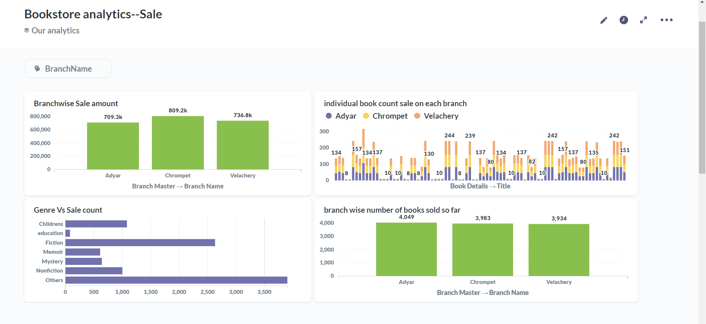
BookStoreSale-Analysis

Slide 3
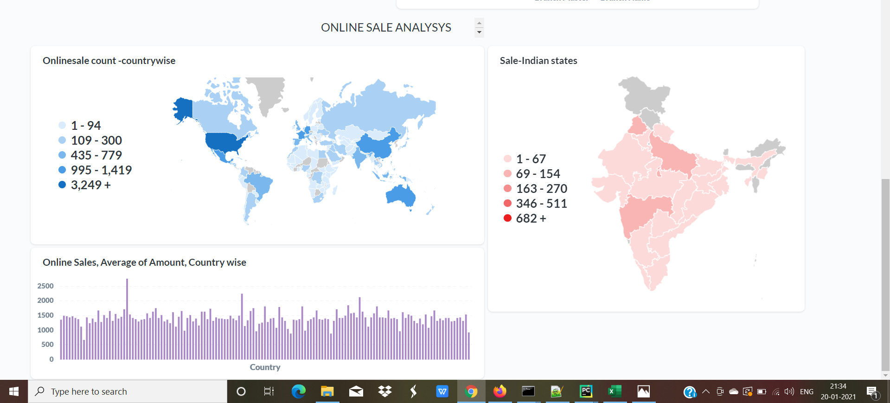
Online Sale Analysis

Slide 4
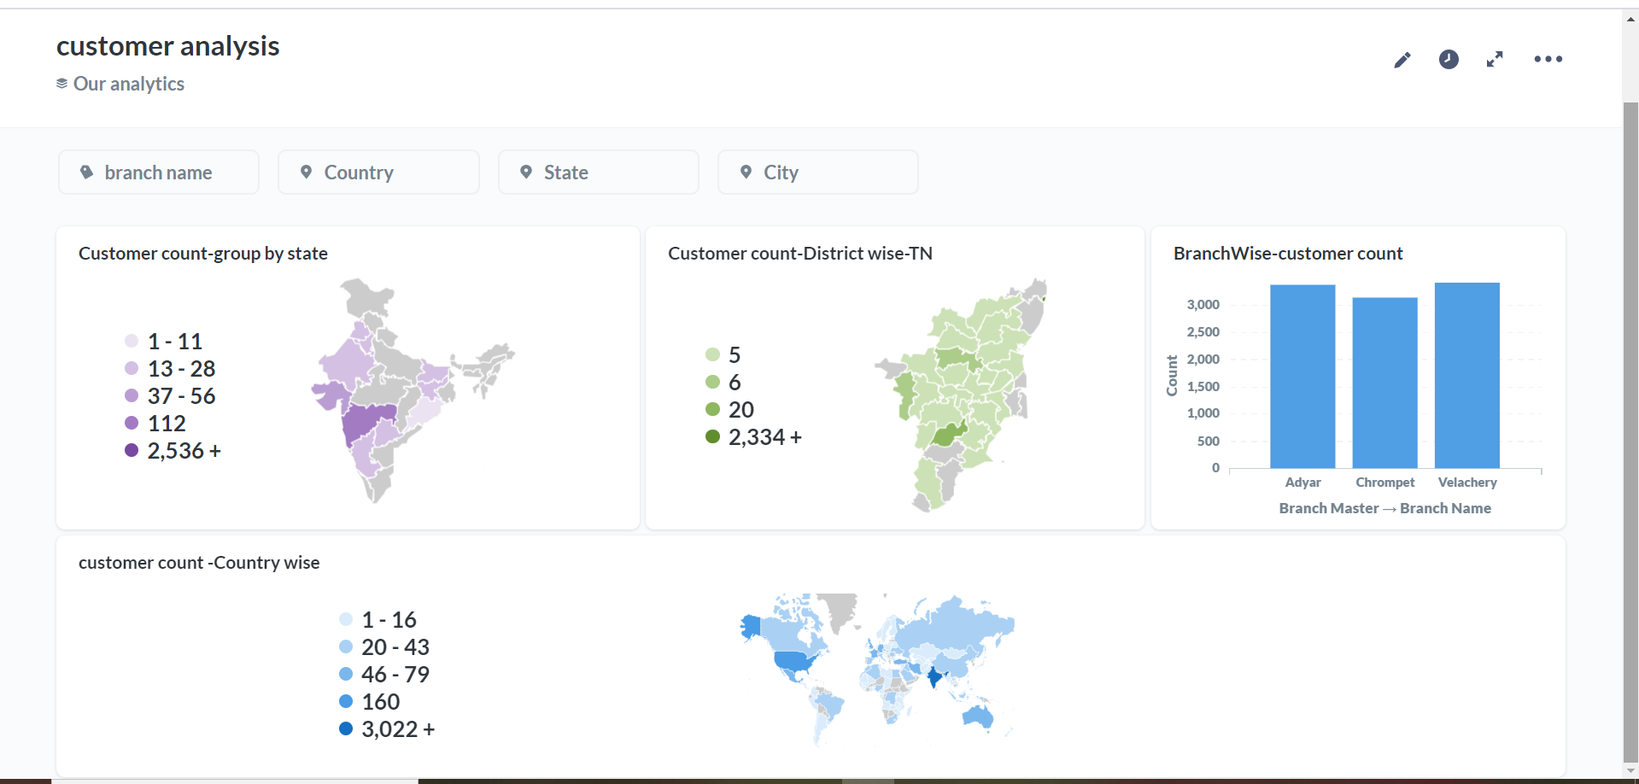
Customer Analysis

Slide 5
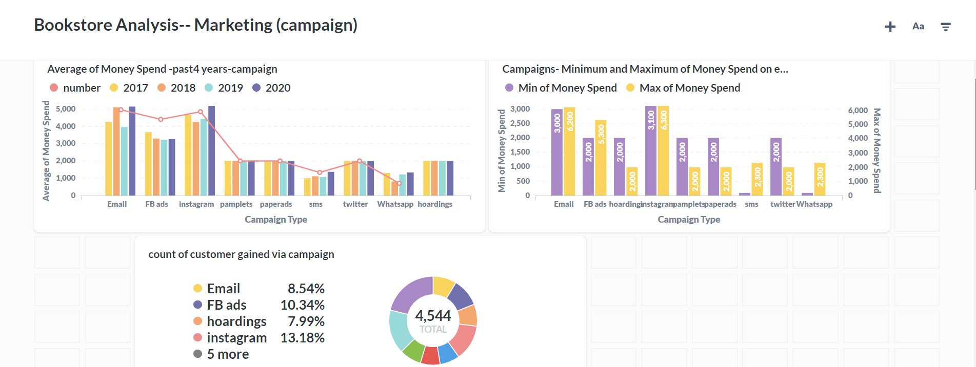
Campaign Analysis

Slide 6
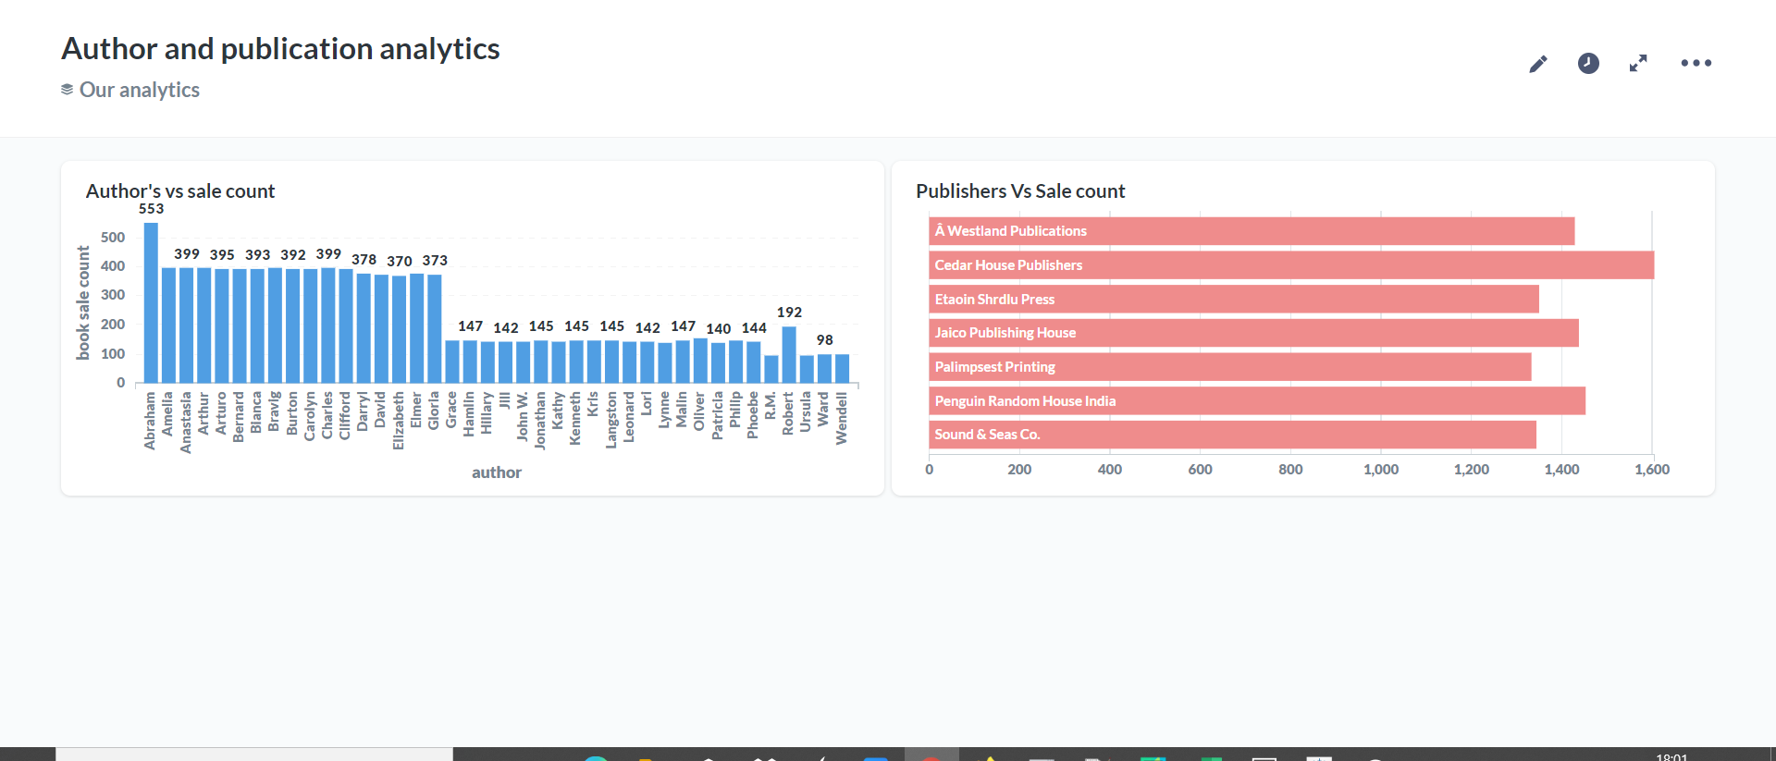
Publishers and Author Analysis

Slide 7
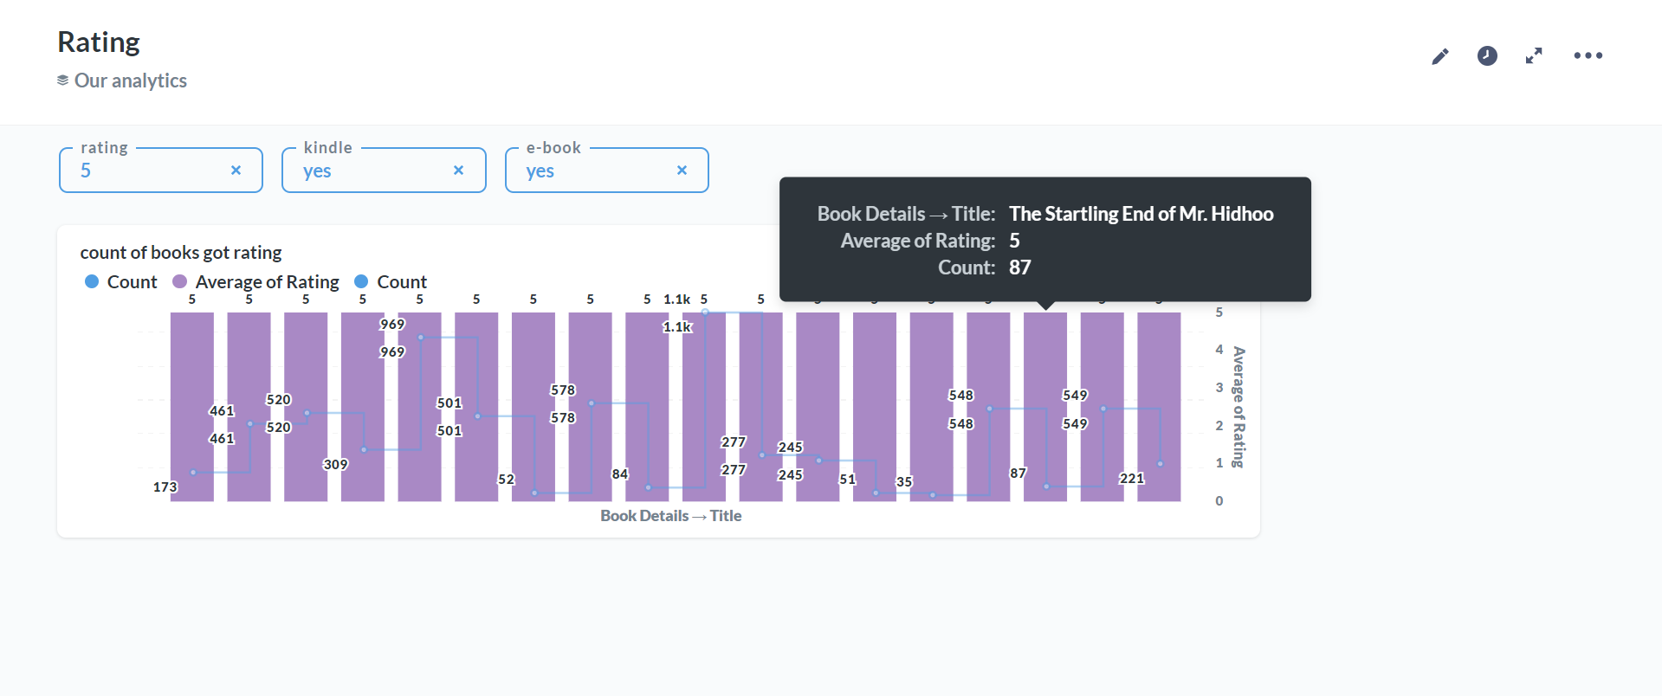
Books Rating Analysis

Slide 8
Tableau DashBoards

Slide 9
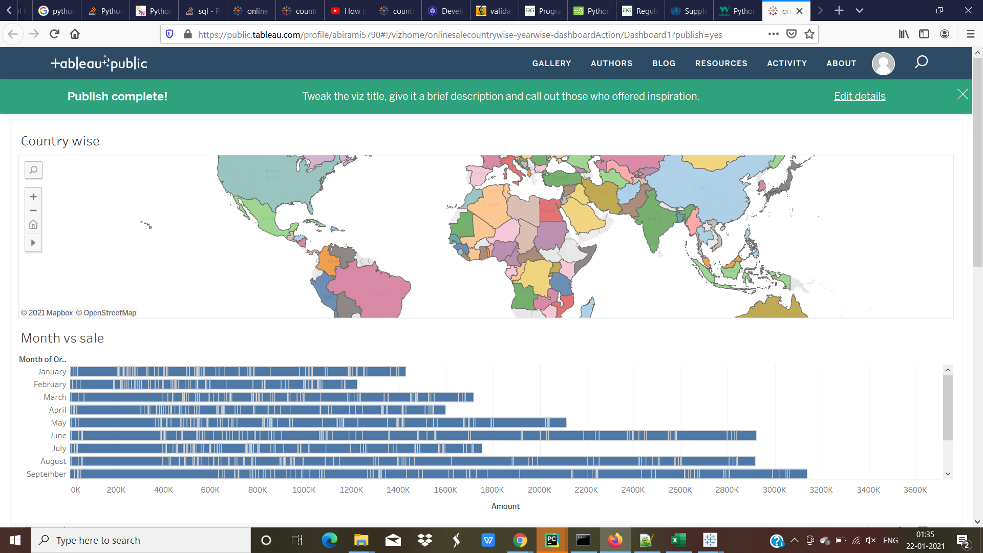
Country wise Sale Analysis using Dashboard Filters
Click here to view Tableau Dashboard -Country wise sale

Slide 10
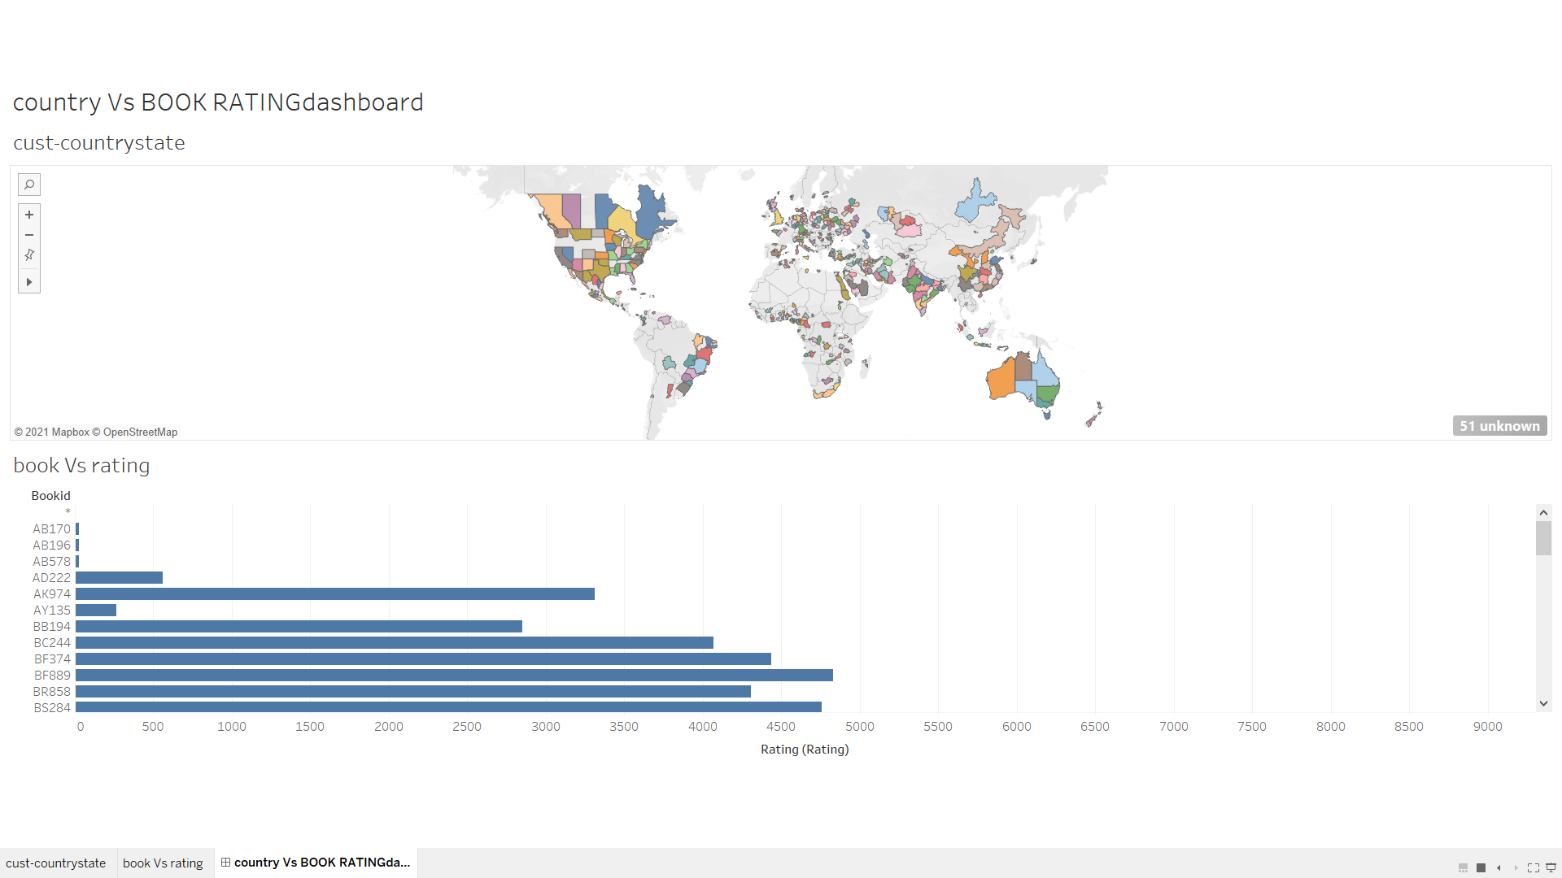
Rating Vs Country(statewise) -usingDashBoard filters
Click here to view Tableau dashboard

